Slide 1
STOR 455 Model Diagnostics and Inference for Coefficients
Read: 1.5, 2.1, 4.4
Exercises: 4.11abcd, 2.15b

Slide 2
Types of “Unusual” Points in SLM
Outlier: A data point that is far from the regression line.
Influential point: A data point that has a large effect on the regression fit.
How do we measure “far”?
How do we measure “effect on the fit”?

Slide 3
Detecting Unusual Cases - Overview
1. Compute residuals
“raw”, standardized, studentized
2. Plots of residuals (or std. residuals)
Boxplot, scatterplot, normal plot
3. Leverage
Unusual values for the predictors
4. Cook’s distance
Cases with large influence

Slide 4

Standardized Residuals
For residuals: mean=0 and std. dev. $≈{\hat{σ}}_{ε}$
Standardized
Residual ≈
Look for values
beyond ±2 (mild) or beyond ±3
(almost)
Definition: The standardized residuals are:
Leverage

Slide 5
Studentized Residuals
Definition: The studentized residuals are:
Using model fit without i^{th} case

Slide 6

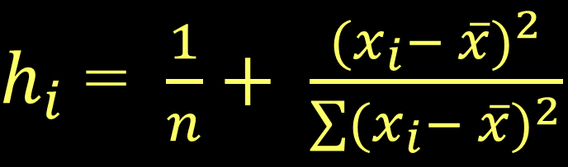
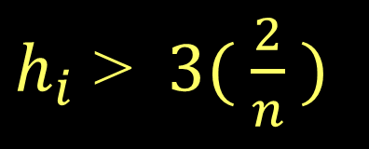
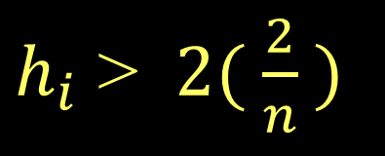
Typical Leverage
$h_{i}$ = $\frac{1}{n}+ \frac{{(x_{i}− \overline{x})}^{2}}{\sum{{(x_{i}− \overline{x})}^{2}}}$
For a simple linear model:
= 1+ 1 = 2
Look for:
$h_{i}$ > $2( \frac{2}{n} )$
or
$h_{i}$ > $3( \frac{2}{n} )$

Slide 7
Leverage
2*(2/28)
3*(2/28)
sort(hatvalues(GoldModel), decreasing = TRUE)
[1] 0.1428571
[1] 0.2142857
1 28 2 27 3 4 26
0.13075010 0.12573712 0.11825693 0.11358967 0.11234035 0.10664378 0.10232224
5 25 24 6 23 7 22
0.09591065 0.09193483 0.08242745 0.07708445 0.07380009 0.06899139 0.06605275
8 21 9 20 10 19 18
0.06177835 0.05918543 0.05544533 0.05319813 0.04999234 0.04809086 0.04386361
17 11 16 12 15 13 14
0.04051638 0.03891349 0.03804918 0.03698058 0.03646200 0.03592770 0.03575484

Slide 8
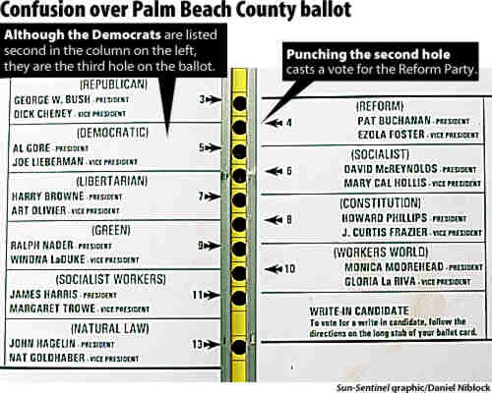
Example: Palm Beach Butterfly Ballot
2000 U.S. Presidential Election: Florida
George Bush 2,912,790
Al Gore 2,912,253

Slide 9
Dataset: PalmBeach
ElectionModel=lm(Buchanan~Bush,data=PalmBeach)
plot(Buchanan~Bush,data=PalmBeach)
abline(ElectionModel)
points(PalmBeach$Bush[50], PalmBeach$Buchanan[50], col="red", pch=16)
County vote counts in Florida (n=67) for George Bush and Pat Buchanan in 2000.
Model: Use Bush votes to predict Buchanan votes.

Slide 10
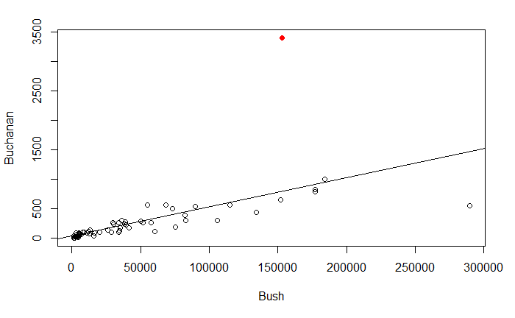
Example: Palm Beach Butterfly Ballot
Palm Beach

Slide 11
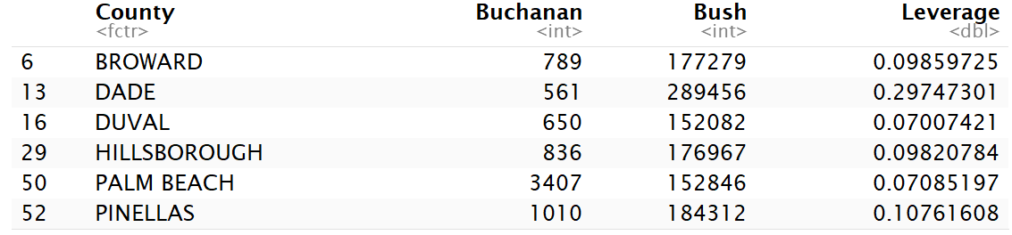
Palm Beach Leverage
> 2*(2/67)
> 3*(2/67)
> head(sort(hatvalues(ElectionModel),decreasing=TRUE),n=10)
[1] 0.05970149
[1] 0.08955224
13 52 6 29 50 16 48
0.29747301 0.10761608 0.09859725 0.09820784 0.07085197 0.07007421 0.05365982
5 36 53
0.03899504 0.03331541 0.02511932
> PalmBeach$Leverage = hatvalues(ElectionModel)
> PalmBeach[c(6,13,16,29,50,52),]

Slide 12
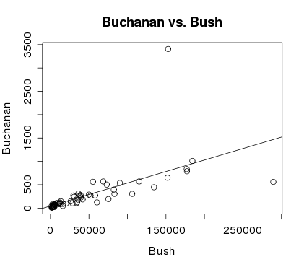
Example: Palm Beach Butterfly Ballot
Palm Beach
Dade

Slide 13
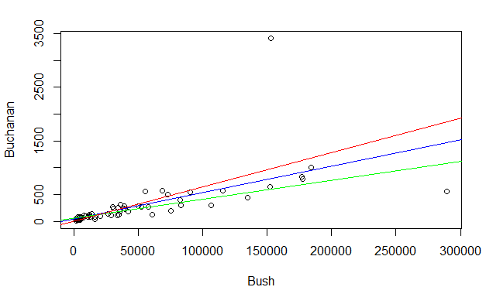
Palm Beach Leverage
plot(Buchanan~Bush,data=PalmBeach)
abline(ElectionModel, col="blue")
NoPalmBeach = subset(PalmBeach,County!="PALM BEACH")
ElectionModel_noPB = lm(Buchanan~Bush,data= NoPalmBeach)
abline(ElectionModel_noPB, col="green")
NoDade = subset(PalmBeach,County!="DADE")
ElectionModel_noDade = lm(Buchanan~Bush,data= NoDade)
abline(ElectionModel_noDade, col="red")

Slide 14
Cook’s Distance
How much would the fit change if one data value were omitted?
k is the number of predictors. In SLM k=1.
D_{i} increases with either poor fit (std.res_{i}) and high leverage (h_{i}).
Compare to other D_{i}’s.
Study any case with D_{i} > 0.5; worry if D_{i} > 1.0.

Slide 15
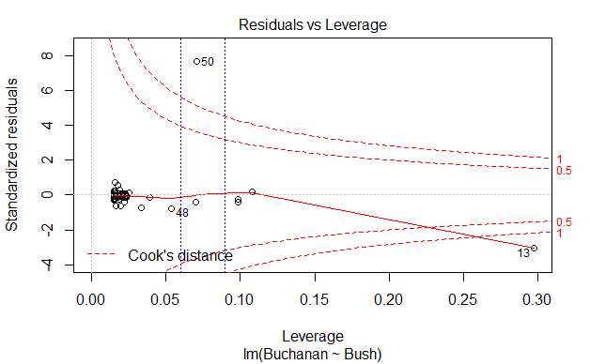
Cook’s Distance
plot(ElectionModel,5)
abline(v = 4/67, col="blue", lty=3)
abline(v = 6/67, col="blue", lty=3)

Slide 16
Inference for Slope and Intercept
Find a confidence interval of plausible values for the parameter.
Test a hypothesis about a possible value for the parameter

Slide 17
Simple Linear Regression
modlego2 = lm(Amazon_Price^(0.3)~Pieces, data=lego_under_800_pieces)
summary(modlego2)
Call:
lm(formula = Amazon_Price^(0.3) ~ Pieces, data = lego_under_800_pieces)
Residuals:
Min 1Q Median 3Q Max
-1.10548 -0.35676 -0.07156 0.25655 2.99219
Coefficients:
Estimate Std. Error t value Pr(>|t|)
(Intercept) 2.311e+00 2.949e-02 78.36 <2e-16 ***
Pieces 2.230e-03 9.029e-05 24.70 <2e-16 ***
---
Signif. codes: 0 ‘***’ 0.001 ‘**’ 0.01 ‘*’ 0.05 ‘.’ 0.1 ‘ ’ 1
Residual standard error: 0.4807 on 716 degrees of freedom
(393 observations deleted due to missingness)
Multiple R-squared: 0.4601, Adjusted R-squared: 0.4593
F-statistic: 610.1 on 1 and 716 DF, p-value: < 2.2e-16

Slide 18
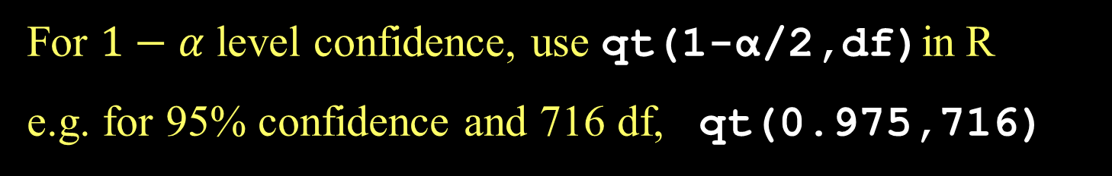
CI for Slope or Intercept
t* comes from a t-distribution with n-2 d.f and depends on the level of confidence
For $1−α$ level confidence, use qt(1-α/2,df)in R
e.g. for 95% confidence and 716 df, qt(0.975,716)

Slide 19
How to find a confidence interval?
confint(mymodel,level =0.XX) and adjust for the confidence level.
2.5 % 97.5 %
(Intercept) 2.253166766 2.368979914
Pieces 0.002052779 0.002407299

